Slide 1
Introduction to API and FastAPI

Slide 2
What is an API?
An API (Application Programming Interface) is a set of rules and protocols that allows two different software programs to communicate with each other and exchange data.

Slide 3
How does an API works?
A common way to understand APIs is to imagine a restaurant scenario:
You (the client application) are the customer who wants a meal (data or functionality).
The API (the waiter) takes your request (order) to the kitchen (the server or external system).
The server/kitchen processes the request (prepares the food).
The API/waiter delivers the response (the meal) back to you.

Slide 4
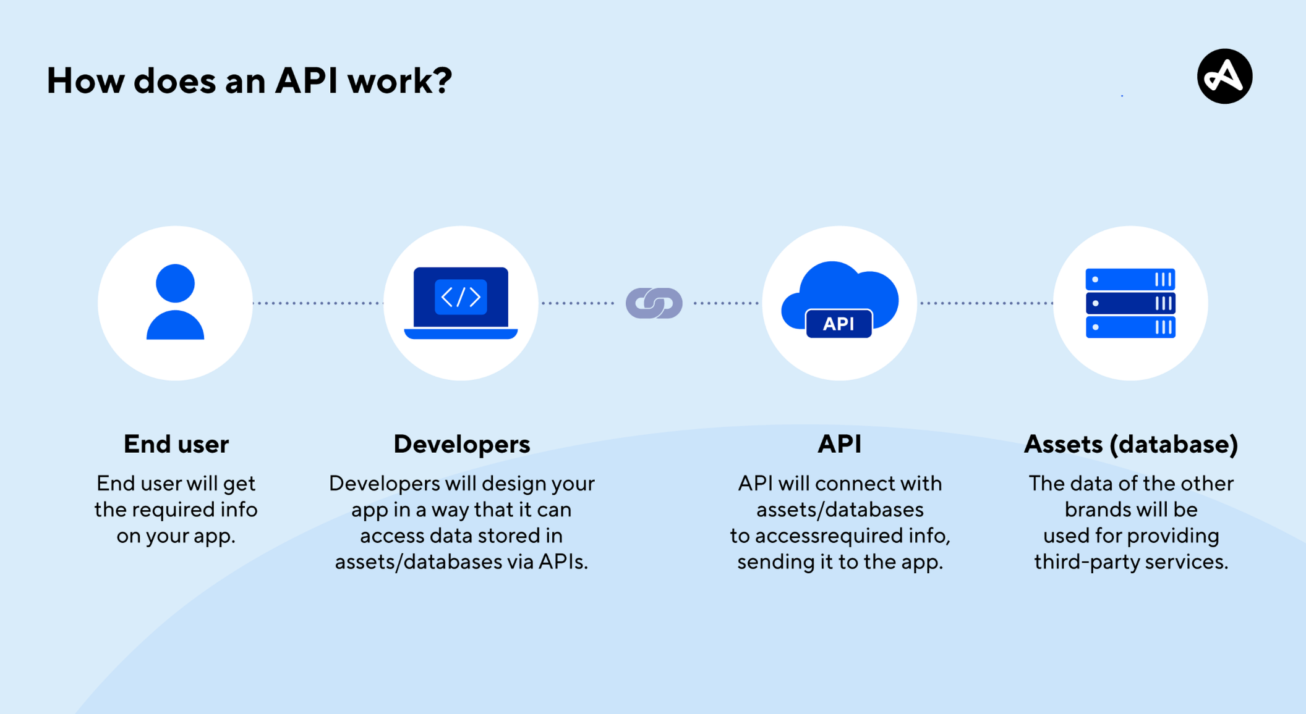

Slide 5
Endpoints: These are specific URLs where an API can be accessed. A request is sent to a particular endpoint to perform a defined action.
Request/Response Cycle: Communication typically happens over the internet using standard protocols like HTTP, where a client sends a request (e.g. using a GET, POST, PUT or DELETE method) and the server returns a response, often in formats like JSON or XML.

Slide 6
HTTP Methods (CRUD)
Create
Creates a new resource POST
Read
Retrieve resource(s) GET
Update
Modify existing resource PUT
Delete
Remove a resource DELETE

Slide 7
FastAPI:
FastAPI is a modern, high-performance web framework for building APIs with Python.
Key Features:
High Performance
Automatic Interactive Documentation
Data Validation and Serialization
Asynchronous Support

